Slide 1
Virtual Memory
Chapter 9
Supplemental Instructor Slides and Notes for
CS 3100

Slide 2
Hardware and Control (Review)
Memory references are dynamically translated into physical addresses at run time
  A process may be swapped in and out of main memory such that it occupies different regions at different times.
Also, a process may be broken up into pieces that do not need to located contiguously in main memory
  All pieces of a process do not need to be loaded in main memory during execution
Notes:
Think about these key points. A program is broken into many processes, and many processes can be in various locations in main memory. When a process is swapped out, it may not return to the same physical memory address it had before.

Slide 3
Execution of a Program (Review)
Operating system brings into main memory a few pieces of the program
Resident set - portion of process that is in main memory
An interrupt is generated when an address is needed that is not in main memory
Operating system places the process in a blocking state
Notes:
So, when another portion of a program (process) is needed, its memory address is checked to see if it is currently residing in main memory.

Slide 4
Execution of a Program (Review)
Piece of process that contains the logical address is brought into main memory
  Operating system issues a disk I/O Read request
  Another process is dispatched to run while the disk I/O takes place
  An interrupt is issued when disk I/O completes, which causes the operating system to place the affected process in the Ready state
Notes:
Remember, while the disk I/O is taking place, another process can be running on the CPU. This should all be a review so far…

Slide 5
MMU vs. Paging (Review)
MMU used to dynamically relocate logical to physical address space.
  Leads to External Fragmentation
  Compaction is not “useful work” for the CPU
Paging
  Still allows for dynamic mapping into frames, but with fixed sizes (to avoid fragmentation)
  Page size typically 512 bytes to 8kb (4kb most common).

Slide 6
Virtual Memory Background
Virtual memory – separation of user logical memory from physical memory.
  Only part of the program needs to be in memory for execution.
  Logical address space can therefore be much larger than physical address space.
  Need to allow pages to be swapped in and out.
Virtual memory can be implemented via:
  Demand paging (discussed in these slides)
  Demand segmentation (discussed in book)
  Or a Combination of the two
Notes:
Bottom line, physical memory is expensive, and not big enough to accommodate all portions of a process. Therefore, a VM scheme is necessary…and effective, as you’ll see…

Slide 7
Translation Lookaside Buffer
Each virtual memory reference can cause two physical memory accesses
  one to fetch the page table
  one to fetch the data
To overcome this problem a high-speed cache is set up for page table entries
  called the TLB - Translation Lookaside Buffer
Notes:
This gives more info, in detail how the TLB actually works…

Slide 8
Translation Lookaside Buffer
Contains page table entries that have been most recently used
Functions same way as a memory cache
First checks if page is already in main memory
  if not in main memory a page fault is issued
The TLB is updated to include the new page entry

Slide 9
Translation Lookaside Buffer
Given a virtual address, processor examines the TLB
If page table entry is present (a hit), the frame number is retrieved and the real address is formed
If page table entry is not found in the TLB (a miss), the page number is used to index the process page table
Notes:
Thus, saving time…

Slide 10
Demand Paging
Bring a page into memory only when it is needed.
  Less I/O needed, Less memory needed
  Faster response, Supports More processes/users
As Page is needed ⇒ check reference to it
  Invalid reference ⇒ abort
  Not-in-memory ⇒ bring to memory

Slide 11
Demand Paging
With each page table entry, a valid–invalid bit is associated.
(1 ⇒ in-main memory, 0 ⇒ not-in-main memory)
Initially valid–invalid bit is set to 0 on all entries.

Slide 12
Demand Paging (cont)
Example of a page table snapshot.
During address translation, if valid–invalid bit in page table entry is 0 ⇒ page fault.
Frame #
valid-invalid bit
1
1
1
1
0
...
0
0
page table

Slide 13
Demand Paging
Demand Paging works because of the principle of locality:
  Program and data references within a process tend to cluster together on the hard drive
  Only a few pieces of a process will be needed over a short period of time
  Possible to make intelligent guesses about which pieces will be needed in the future
  This suggests that virtual memory may work efficiently

Slide 14
Demand Paging
If there is ever a reference to a page that doesn’t exist in memory, its reference will trap to OS ⇒ page fault.
OS decides:
  Invalid reference ⇒ (terminate process)
  Or Valid, but just not in memory.
If Valid, Get empty frame.
If no empty frame, use replacement algorithm (later slides) to find one
Swap page into frame.
Reset table, validation bit = 1.
Restart instruction – the process now accesses the page as though it had always been in memory.

Slide 15
Smaller Page Sizes
Smaller page size = less internal fragmentation
But, more pages are required per process
More pages per process means larger page tables
Larger page tables means large portion of page tables are stored in virtual memory

Slide 16
Larger Page Size
Larger page size, more of the process will be found in main memory
The pages in memory will all contain portions of the process near recent references (other portions of the program or process). Page faults low.
BUT as time goes on during execution, Increased page size causes pages to contain locations further from any recent reference. Page faults rise.

Slide 17
Variable Page Size
Multiple page sizes provide the flexibility needed to effectively use a TLB
  Large pages can be used for program instructions
  Small pages can be used for threads
However, most operating system support only one page size (typically 4kb).

Slide 18
Dealing with Large Page Tables
Multi-Level Page Tables
  Page the page table
  Modern processors have a 3 or 4 level page table
Inverted Page Tables
  Map the physical frames into logical pages
  Relies heavily on the TLB

Slide 19
Thrashing
If a process does not have “enough” pages, the page-fault rate is very high. This leads to:
  Low CPU utilization.
  Operating system thinks that it needs to increase the degree of multiprogramming.
  Another process added to the system.
Thrashing ≡ a process is spending more time swapping pages than executing.

Slide 20

Thrashing Diagram

Slide 21
Thrashing (cont)
Why does thrashing occur?
Σ size of process locality > total memory size (allocated frame size)
Solution: Limit thrashing by using a local replacement algorithm
Prevent over-allocation of memory (too much multiprogramming) by modifying page-fault service routine to include page replacement.
Use modify (dirty) bit to reduce overhead of page transfers – only modified pages are written to disk.

Slide 22
Page Fault Service Routine
Find the location of the desired page on the disk.
Find a free frame:
  If there is a free frame, use it.
  Otherwise, use a page replacement algorithm to select a victim frame.
  Write the victim page to the disk; change the page and frame tables accordingly.
Read the desired page into the (newly) free frame; change the page and frame tables.
Restart the user process.

Slide 23
Page-Replacement Algorithms
Want lowest page-fault rate.
Evaluate algorithm by running it on a particular string of page references (reference string) and compute the number of page faults on that string.
In all our examples (these slides), the reference string is
1, 2, 3, 4, 1, 2, 5, 1, 2, 3, 4, 5

Slide 24
Optimal Algorithm
Replace page that will not be used for longest period of time.
4 frames example
1, 2, 3, 4, 1, 2, 5, 1, 2, 3, 4, 5
1
4
2
6 page faults
3
4
5
Notes:
Note You ALWAYS have at a minimum the number of pages in the frame. In other words, when 1, 2, 3, and 4 are first brought in, the frame pages are empty, so right off the bat, you get four page faults. The next entries 1 and 2 do not page fault (because they’re in memory). 5 will page fault, 1 won’t, etc….

Slide 25
Optimal Algorithm (cont)
In practice, how do you determine the page to be replaced?
This algorithm is used only for measuring how well other algorithms perform.

Slide 26
First-In-First-Out Algorithm
Reference string: 1, 2, 3, 4, 1, 2, 5, 1, 2, 3, 4, 5
3 frames (3 pages can be in memory at a time per process)
1
1
4
5
2
2
1
3
9 page faults
3
3
2
4
Notes:
In this example, we make the frame size 3 pages…however, as you’ll see next slide, increasing the frame size DOES NOT necessarily mean less page faults when FIFO is used.

Slide 27
FIFO Algorithm (cont)
4 frames
FIFO Replacement suffers from – Belady’s anomaly.
  Allocating More frames does not mean less page faults!
1
1
5
4
2
2
1
5
10 page faults
3
3
2
4
4
3
Notes:
See what I mean…. Research Belady’s Anomaly.

Slide 28
Least Recently Used (LRU) Algorithm
Reference string: 1, 2, 3, 4, 1, 2, 5, 1, 2, 3, 4, 5
Counter implementation
  Every page entry has a counter; every time the page is referenced through this entry, the clock is copied into the counter.
  The page to be replaced is the one that has the smallest (LRU) value.
1
5
2
3
5
4
4
3

Slide 29
Counting Algorithms
Keep a counter of the number of references that have been made to each page.
LFU (Least Frequently Used) Algorithm: replace the page with the smallest count.
MFU (Most Frequently Used) Algorithm: based on the argument that the page with the smallest count was probably just brought in and has yet to be used.

Slide 30
Allocation of Frames
Each process needs minimum number of pages.
There are a fixed number of frames available.
So, how do we determine how many frames to allocate to a process?
Two major allocation schemes.
  Local (Fixed allocation)
  Global (Priority allocation)

Slide 31
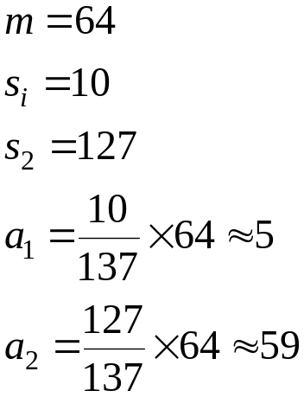
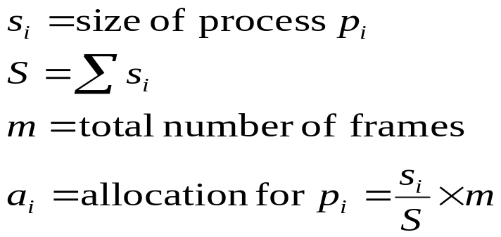
Fixed Allocation
Local replacement – each process selects from only its own set of allocated frames.
Equal allocation – e.g., if 100 frames and 5 processes, give each 20 pages.
  Remainder goes to Free Frame Buffer
Proportional allocation – Allocate according to the size of process.

Slide 32
Priority Allocation
Global replacement – process selects a replacement frame from the set of all frames; one process can take a frame from another.
Global replacement can lead to “Thrashing”

